Slide 1
CS 331
Topic: C-Strings and String Class
MD Romael Haque

Slide 2
Character Testing
The C++ library provides several functions that allow you to test the value of a character.
These functions test a single char argument and return either true or false.
To use these functions you must include the <cctype> header file.

Slide 3
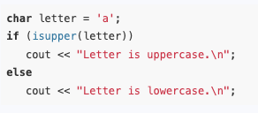
Character Testing
For example, the following program segment uses the isupper function to determine whether the character passed as an argument is an uppercase letter.
If it is, the function returns true. Otherwise, it returns false.
Because the variable letter, in this example, contains a lowercase character, isupper returns false.
The if statement will cause the message "Letter is lowercase" to be displayed.

Slide 4
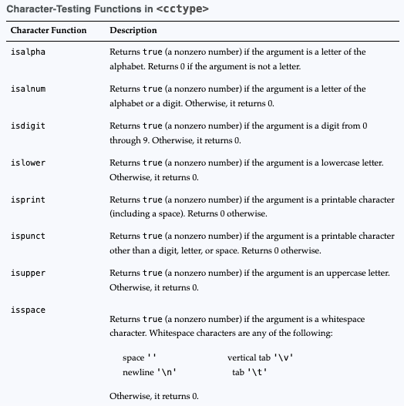
Character-Testing Functions in <cctype>

Slide 5
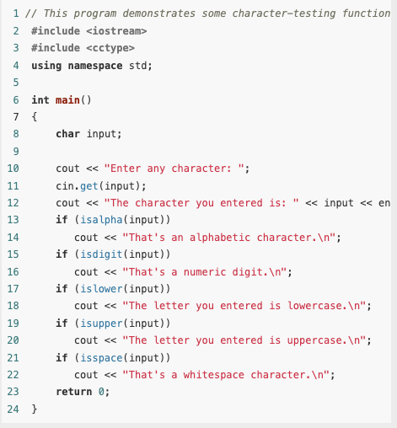
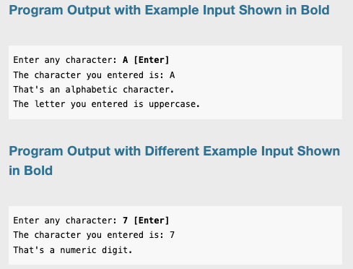
Example

Slide 6
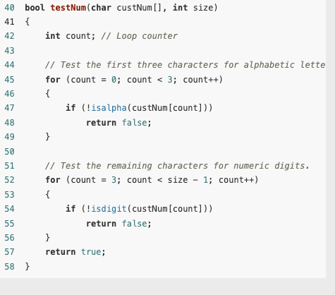
Example
In this program, the customer number is expected to consist of three alphabetic letters followed by four numeric digits.
The testNum function accepts an array argument and tests the first three characters with a loop (Lines 45-49).

Slide 7
Example
The isalpha function returns true if its argument is an alphabetic character.
The ! operator is used in the if statement to determine whether the tested character is NOT alphabetic.
If this is so for any of the first three characters, the function testNum returns false.

Slide 8
Example
Likewise, the next four characters are tested to determine whether they are numeric digits with a loop (Lines 52-56)
The isdigit function returns true if its argument is the character representation of any of the digits 0 through 9.
Once again, the ! operator is used to determine whether the tested character is not a digit. If this is so for any of the last four characters, the function testNum returns false.

Slide 9
Example
If the customer number is in the proper format, the function will cycle through both the loops without returning false.
In that case, the last line in the function is the return true statement, which indicates the customer number is valid.

Slide 10
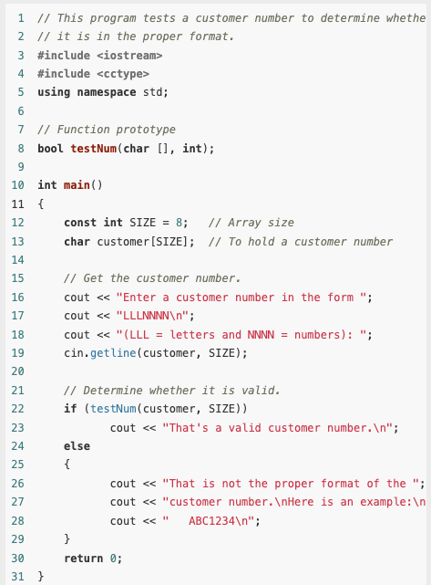
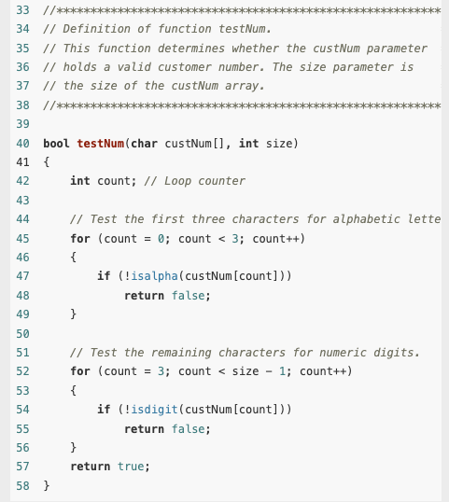
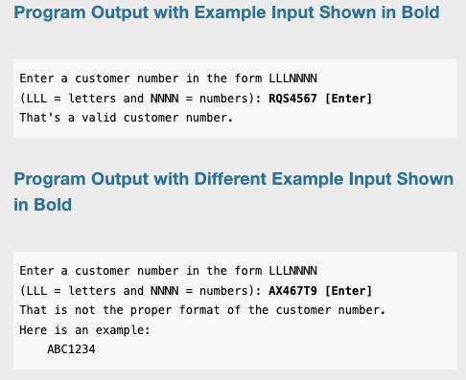
Complete Example

Slide 11
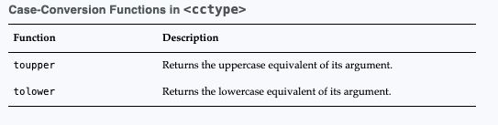
Character Case Conversion
The C++ library offers functions for converting a character to uppercase or lowercase.
The C++ library provides two functions, toupper and tolower, for converting the case of a character.

Slide 12
Character Case Conversion
Each of the functions accepts a single character argument.
If the argument is a lowercase letter, the toupper function returns its uppercase equivalent.
For example, the following statement will display the character A on the screen: cout << toupper('a’);
If the argument is already an uppercase letter, toupper returns it unchanged.

Slide 13

Character Case Conversion
Any nonletter argument passed to toupper is returned as it is.
Each of the following statements displays toupper’s argument without any change:

Slide 14
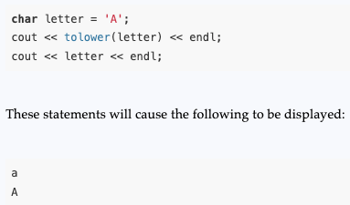
Character Case Conversion
toupper and tolower don’t actually cause the character argument to change; they simply return the uppercase or lowercase equivalent of the argument.
For example, in the following program segment, the variable letter is set to the value ‘A’.
The tolower function returns the character ‘a’, but letter still contains ‘A’.

Slide 15
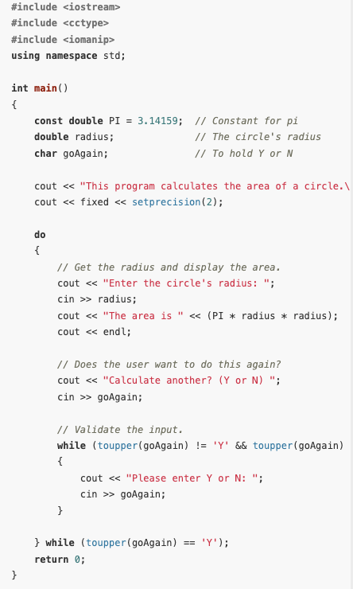
Example
In lines 28 and 29, the user is prompted to enter either Y or N to indicate whether he or she wants to calculate another area.
We don’t want the program to be so picky that it accepts only uppercase Y or uppercase N.
Lowercase y or lowercase n is also acceptable.
The input validation loop must be written to reject anything except 'Y', 'y', 'N', or 'n'.

Slide 16
C-Strings
Many programs make extensive use of strings.
C++ provides two different data types for working with strings: C-strings and the string class.
The string class library has many functions for working with strings.
These functions perform many useful string-related functions and have programming safeguards that C-string handling functions lack.
For all these reasons, you should prefer use of the string class over C-strings.

Slide 17
C-Strings
Nevertheless, every C++ programmer should have a good understanding of C-strings.
The string class is built on top of C-strings, so understanding C-strings helps you to understand the string class.
There are also many programs that were written before the string class library was incorporated into the C++ standard.
Such programs need programmers who understand C-strings to maintain them.
Finally, programmers who write and maintain low-level code, such as the string class libraries and parts of the operating system, must use C-strings to represent string data.

Slide 18

C-Strings
A C-string is a sequence of characters stored in consecutive memory locations and terminated by a null character.
Recall that the null character is the character whose ASCII code is 0. In a program, the null character is usually written ‘\0’.
It is also common to use the integer 0 or the constant NULL to denote the null character in a program.
Thus, all of the following statements store the null character into a character variable:

Slide 19
C-Strings
Because an array is a sequence of consecutive memory locations that store values of the same type, a C-string is really a null-terminated array of characters. C-strings can appear in a program in one of three forms:
“Hard-coded” string literals
Programmer-defined arrays of character
Pointers to character

Slide 20
C-Strings
Regardless of which one of the three forms a C-string appears in a program, a C-string is always a null-terminated array of characters and is represented in the program by a pointer to the first character in the array.
In other words, the type of a C-string is char *
That is, the type of a C-string is pointer to char.

Slide 21

String Literals
String literals, also called string constants, are written directly into the program as a sequence of characters enclosed in double quotes: For example, these two are both string literals. "What is your name?" "Bailey"
When the compiler encounters a string literal such as "Bailey", it allocates an array of seven characters, stores the six characters of "Bailey" in the first six entries of the array, and then stores the null character in the last entry.
The compiler treats the address of the first character of the array (which has type char *) as the value of the string literal.

Slide 22
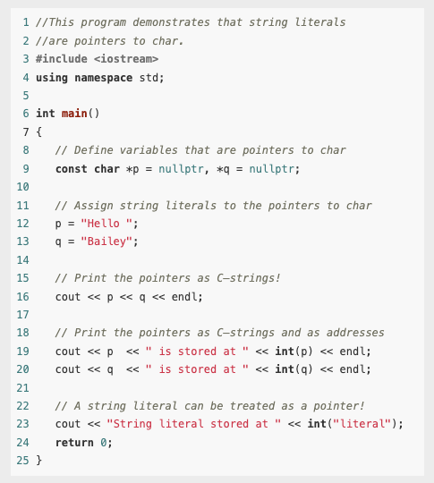
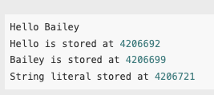
Example
The first two assignments of the program show that string literals are pointers to char by assigning them to variables of type char *.
The pointers p and q then hold the addresses of the two string literals.
By casting the pointers to int, we can see where in memory the string literals are stored.
Notice that in this case, the compiler has stored all string literals in the program in consecutive memory locations.

Slide 23
Programmer-Defined Arrays of Character
String literals can only hold C-strings that are hard-coded into the program.
Hard-coded means the literal is directly defined in the source code, and its value is determined at compile-time.
You cannot dynamically generate or modify the content of a string literal at runtime.
Since string literals reside in a read-only section of memory, they cannot be changed.

Slide 24

Programmer-Defined Arrays of Character
To have a C-string whose characters are read from the keyboard or a file, you must explicitly define an array to hold the characters of the C-string.
In doing this, you should make sure that you allocate an additional entry in the array for the terminating null character.
For example, if your C-string will be at most 19 characters long, you will need to allocate an array of 20 characters, as in

Slide 25
Programmer-Defined Arrays of Character
As in the case of literals, the compiler will represent the C-string by the address of the first character of the string, in this case, the array identifier.
We know that an array identifier without the brackets is interpreted by the compiler to be the address of the first entry of the array.
A C-string defined as an array can be given its value by initializing it with a string literal, by reading characters into it from the keyboard or a file, or by copying characters into the array one character at a time.

Slide 26

Programmer-Defined Arrays of Character
When initializing an array with a string literal in this manner, the size of the array in the array definition is optional.
If not specified, the compiler will set the size to one more than the number of characters in the initializing literal string (thus allowing room for the null terminator).

Slide 27
Programmer-Defined Arrays of Character
C-strings defined as arrays can be read and written using the various objects, operators, and member functions of the input and output stream classes.
A C-string stored as a programmer-defined array can be processed using standard subscript notation.
We will see an example now.
It outputs a string one character at a time, and stops when it finds the null terminator.

Slide 28
Programmer-Defined Arrays of Character
We will use the getline member function.
The getline member function in C++ is used to read an entire line of text from an input stream (like std::cin) into a std::string or a character array.
It stops reading when it encounters a newline character (\n) or when a specified delimiter is reached.
It is commonly used for handling input that may contain spaces.

Slide 29
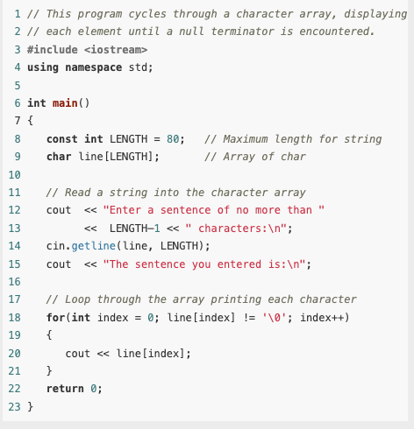
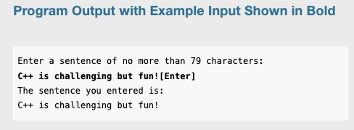
Example

Slide 30
Pointers to char
As we have seen, C-strings can be represented as string literals or as arrays of characters.
Both of these methods allocate an array and then use the address of the array as a pointer to char to actually represent the string.
The difference between the two is that in the first case, the array used to store the string is allocated implicitly by the compiler, whereas in the second, the array is explicitly allocated by the programmer.

Slide 31
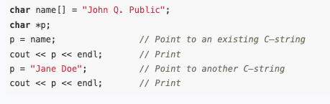
Pointers to char
The third method of representing a C-string uses a pointer to char to point to a C-string whose storage has already been allocated by one of the other two methods.

Slide 32
Pointers to char
A major advantage in using a pointer variable to represent a C-string is the ability to make the pointer point to different C-strings.
This allows the pointer to "switch" between different strings without needing to copy or move data explicitly.
Another way to use a pointer to a char as a C-string is to define the pointer and then set it to point to dynamically allocated storage returned by the new operator.
It Allows creation of C-strings of variable length at runtime.
It’s useful when the size of the string or its content is not known at compile-time.

Slide 33
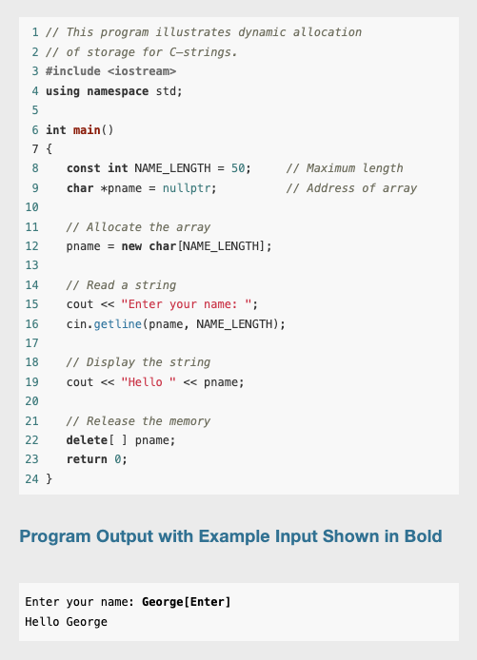
Example
A common mistake when using pointers to char as C-strings is using the pointer when it does not point to a properly allocated C-string.
Without allocation, the program tries to read a string into the memory location pointed to by a pointer, when that pointer has not been properly initialized.

Slide 34
Library Functions for Working with C-Strings
The C++ library provides many functions that can be used to work with C-strings.
There are functions for determining the length of a string, for concatenating two strings, for comparing two strings, and for searching for the occurrence of one string within another.
You must include the <cstring> header file to use these functions.

Slide 35
Passing C-String Arguments
The C-string can be passed to the function in any one of the three forms that a C-string can take:
A string literal
The name of an array that stores the C-string
A pointer variable holding the address of the C-string

Slide 36

The strlen Function
The strlen function is passed a C-string as its argument and returns the length of the string.
This is the number of characters up to, but not including, the null terminator.
The length of a string should not be confused with the size of the array holding it.
Remember, the only information passed to strlen is the beginning of the C-string.
It doesn’t know where the array ends, so it looks for the null terminator to indicate the end of the string.

Slide 37
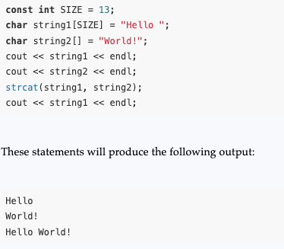
The strcat Function
Another example of a C-string handling function is strcat.
The strcat function takes two strings as parameters and concatenates them, returning a single string that consists of all the characters of the first string followed by the characters of the second string.

Slide 38
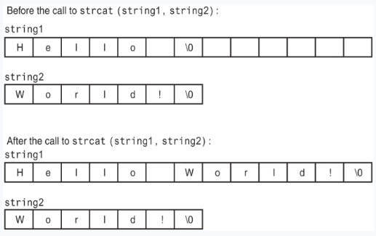
The strcat Function
The strcat function copies the contents of string2 to the end of string1.
In this example, string1 contains the string “Hello ” before the call to strcat. After the call, it contains the string “Hello World!”.

Slide 39
The strcat Function (contd.)
Notice that the last character in string1 (before the null terminator) is a space.
The strcat function doesn’t insert a space, so it’s the programmer’s responsibility to make sure one is already there, if needed.
It’s also the programmer’s responsibility to make sure the array holding string1 is large enough to hold string1 plus string2 plus a null terminator.

Slide 40


The strcpy Function
The strcpy function can be used to copy one C-string to another.
strcpy performs no bounds checking.
The array specified by the first argument will be overflowed if it isn’t large enough to hold the string specified by the second argument.

Slide 41
Comparing C-Strings
The assignment and relational operators work with the C++ string class because they have been overloaded to work with that class.
However, just as the assignment operator cannot be used to assign to C-strings, the relational operators <=, <, >, >=, !=, and == cannot be used to compare C-strings.
This is because when used with C-strings, these operators compare the addresses at which the C-strings are stored instead of comparing the actual sequence of characters that comprise the C-string

Slide 42
The strcmp Function
To properly compare C-strings, you should use the library function strcmp.
This function takes two C-strings as parameters and returns an integer that indicates how the two strings compare to each other.
Prototype: int strcmp(char *string1, char *string2);
The function takes two C-strings as parameters (recall that char * is the type of C-string) and returns an integer result.

Slide 43
The strcmp Function
The value of the result is set according to the following convention:
The result is zero if the two strings are equal on a character-by-character basis.
The result is negative if string1 comes before string2 in alphabetical order.
The result is positive if string1 comes after string2 in alphabetical order.

Slide 44
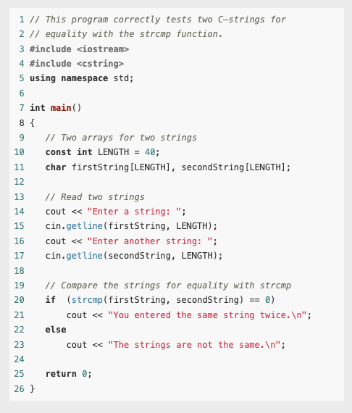

Example

Slide 45
The strcmp Function
The function strcmp is case sensitive when it compares strings. If the user enters “Dog” and “dog”, it will report they are not the same.
Some compilers provide nonstandard versions of strcmp that perform case-insensitive comparisons.
Such functions work identically to strcmp except the case of the characters is ignored.

Slide 46
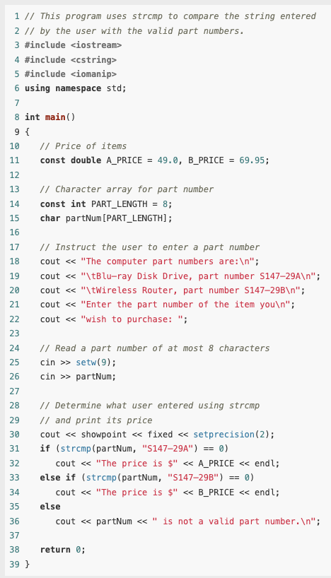
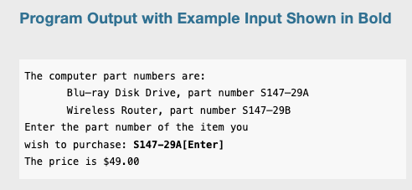
Example

Slide 47

Using ! with strcmp
Some programmers prefer to use the logical NOT operator with strcmp when testing strings for equality.
Since 0 is considered logically false, the ! operator converts that value to true.
The expression !strcmp(string1, string2) will return true when both strings are the same and false when they are different.
The two following statements have exactly the same effect when executed.

Slide 48
Sorting Strings
Because strcmp returns information on the relative alphabetic order of the two strings being compared, it can be used to sort lists of C-strings.
Let’s see an example:

Slide 49
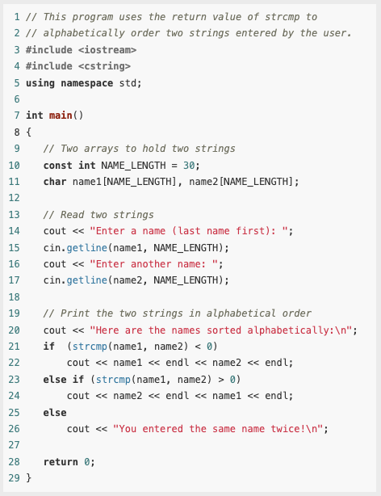
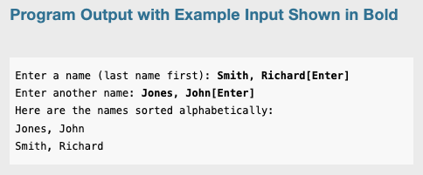
Example

Slide 50
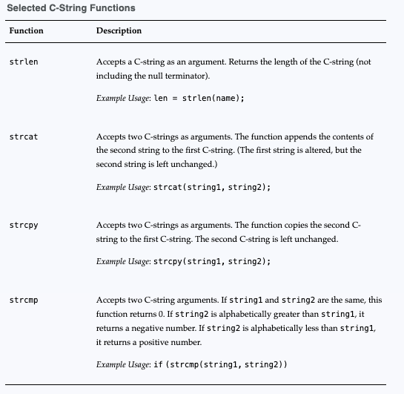
Summary table

Slide 51
Conversions Between Numbers and Strings
The C++ libraries provide functions and classes that can be used to convert a string representation of a number to numeric form and vice versa.

Slide 52
Conversions Between Numbers and Strings
There is a difference between a number that is stored as a string and one stored as a numeric value.
The string “2679” isn’t a number: it is a sequence of ASCII codes of the characters that form the individual digits of the number 2679.
Because the string “2679” is not a number, the compiler will not allow arithmetic operations such as addition, multiplication, and division to be applied to it.
Strings that represent numbers must first be converted to numeric form before they can be used with arithmetic operators.

Slide 53
Conversions Between Numbers and Strings
Similarly, program values that are in the numeric form of types such as int, long, and double sometimes need to be converted to string form.
The resulting string may be immediately output to a file or some other input/output device, or it may be stored in an in-memory string object for later use.

Slide 54
Interesting fact
When a user enters a number at a keyboard, the number is entered in its string form as a sequence of characters (digits) typed by the user.
In C++, such a number is usually read via the stream extraction operator >>.
This operator automatically performs conversions as needed before storing into a variable of numeric type.
During output, the reverse conversion from numeric to string is performed by the stream output operator <<.

Slide 55
Using String Stream Objects for Numeric Conversions
C++ has two classes, ostringstream and istringstream, that can be used to perform string/numeric conversions for in-memory values.
The class ostringstream is a subclass of ostream (the class that cout belongs to) and uses the stream insertion operator << to convert numeric values to string.
Objects of type ostringstream work the same way that cout, except that instead of writing to the screen, ostringstream writes its data to a string object contained inside it.
Each time you use << on the ostringstream object, it performs any numeric-to-string conversions necessary and appends the result to the end of its string.

Slide 56
Using String Stream Objects for Numeric Conversions
The istringstream class derives from istream.
It contains a string object inside it that functions as an input stream that can be “read” from.
The input stream can be set by the istringstream constructor when the object is created, or by calling the str(string s) function after the object has been created.
The stream extraction operator >> reads from the enclosed string and converts from string to numeric where necessary.
You must include the <sstream> header file in your programs to use these classes.

Slide 57
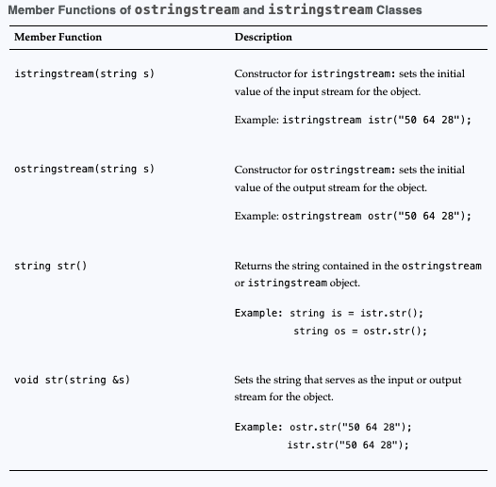
Using String Stream Objects for Numeric Conversions
In addition to supporting all the member functions and operators of the ostream/istream class, ostringstream and istringstream objects support some other member functions as well

Slide 58
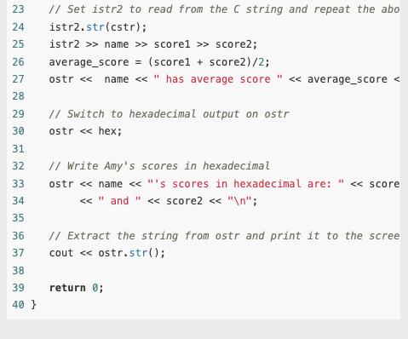
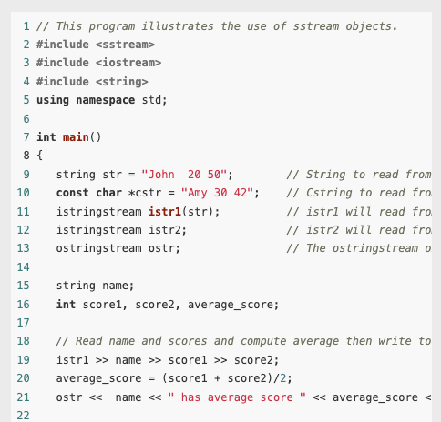
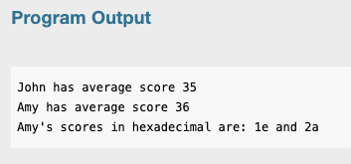
Example

Slide 59
Using String Stream Objects for Numeric Conversions
Notice that these classes have the full power of ostream and istream objects, including the ability to convert numbers to string using different bases such as octal and hexadecimal.
They do have a disadvantage, however, in that they force you to create sstream objects just so you can use their insertion and extraction operators to perform conversions.

Slide 60
Numeric Conversion Functions
C++ 11 provides several to_string(T value) functions to convert a numeric value of type T to string form. Here is a list of a few of the to_string() functions:
string to_string(int value)
string to_string(long value)
string to_string(double value)

Slide 61

Numeric Conversion Functions
The following code fragment illustrates how to use this family of functions. It prints the string

Slide 62

Numeric Conversion Functions
The string-to-numeric conversions are performed by the family of stoX() functions.
The members of this family that perform string conversions to int, long, float, and double are

Slide 63
Numeric Conversion Functions
The first parameter, str, is a string (such as "−342" or "3.48") to be converted to an appropriate numeric form.
These functions will convert to numeric the longest prefix of str possible and return in pos the address of an integer in which to store the index of the first character of str that could not be converted.

Slide 64
Numeric Conversion Functions
The type size_t is defined in the standard library and is commonly used to represent an unsigned integer that is the size of, or an index into, an array, vector, or string.
For example, an attempt to convert the string "−34is even" will succeed and return the integer −34 and set the position of the first character that could not be converted to 3.

Slide 65
Numeric Conversion Functions
The base parameter applies for integral conversions only and indicates the base to be used for the conversion.
The pos and base parameters are optional, so they can be omitted.
If pos is omitted, the index of the stopping character is not stored; and if base is omitted, it is assumed to be 10.
If the string str has an invalid value, such as “is −34 even?", then no conversion can be performed and the function throws an invalid_argument exception

Slide 66
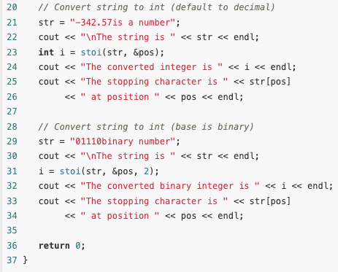
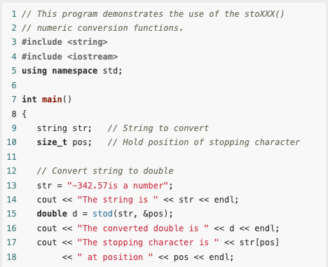
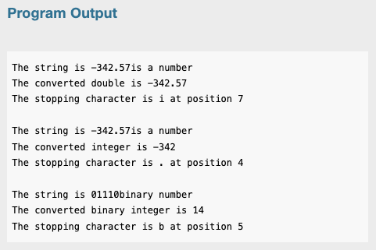
Example

Slide 67
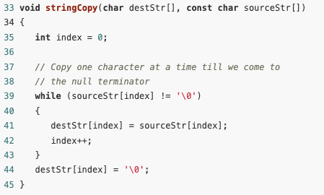
Writing Your Own C-String Handling Functions
You can design your own specialized functions for manipulating strings.
Notice that here the function stringCopy does not accept an argument indicating the size of the arrays.
It simply copies the characters from the source string to the destination until it encounters a null terminator in the source string.
When the null terminator is found, the loop has reached the end of the C-string. =
The last statement in the function assigns a null terminator (the '\0' character) to the end of string2, so it is properly terminated.

Slide 68
Using Pointers to Pass C-String Arguments
Pointers are extremely useful for writing functions that process C-strings.
If the starting address of a string is passed into a pointer parameter variable, it can be assumed that all the characters, from that address up to the byte that holds the null terminator are part of the string.
So, it isn’t necessary to know the length of the array that holds the string.)

Slide 69
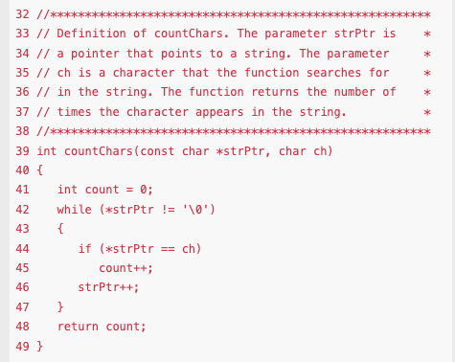
Using Pointers to Pass C-String Arguments
In the function countChars, strPtr points to the C-string that is to be searched and ch contains the character to look for.
The while loop repeats as long the character strPtr points to is not the null terminator

Slide 70
Using Pointers to Pass C-String Arguments
Inside the loop, the following if statement compares the character that strPtr points to with the character in ch: if (*strPtr == ch)
If the two are equal, the variable count is incremented. (count keeps a running total of the number of times the character appears.)

Slide 71
Using Pointers to Pass C-String Arguments
The last statement in the loop is strPtr++;
This statement increments the address in strPtr.
This causes strPtr to point to the next character in the string.
Then the loop starts over. When strPtr finally reaches the null terminator, the loop terminates and the function returns the value in count.

Slide 72
More about the C++ string Class
From an ease-of-programming point of view, the standard library string class offers several advantages over C-strings.
As you have seen throughout this text, the string class has several member functions and overloaded operators.
These simplify tasks, such as locating a character or string within a string, that are difficult and tedious to perform with C-strings.
We will now review some basic operations with strings, then discuss more of the string class’s member functions

Slide 73
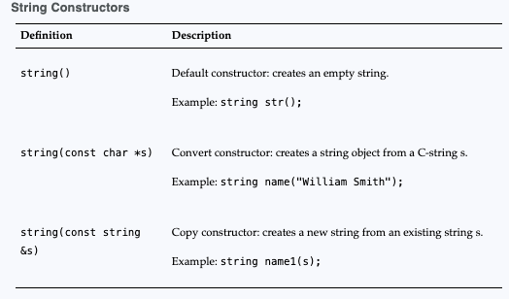
More about the C++ string Class
Any program using the string class must #include the string header file.
String objects may then be created using any of the constructors shown in this table

Slide 74
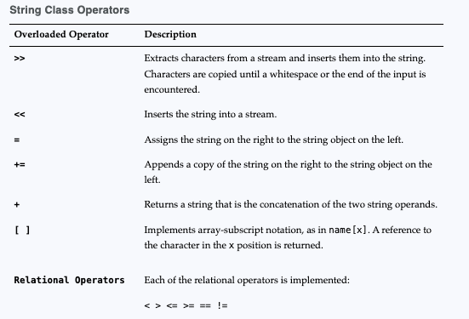
More about the C++ string Class
The string class overloads the operators shown in the following table

Slide 75
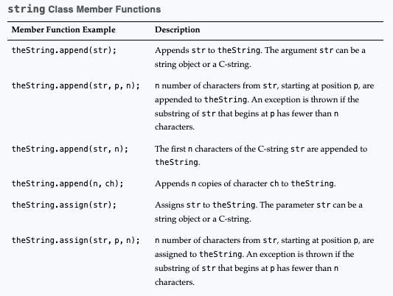
More about the C++ string Class
The string class also has several member functions.
List1 :

Slide 76
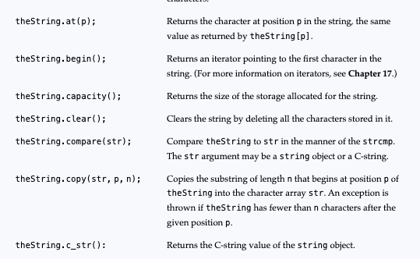
More about the C++ string Class
List 2:

Slide 77
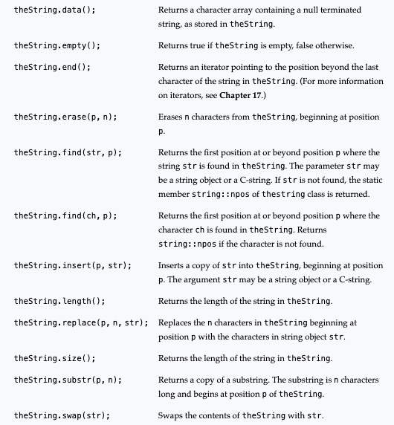
More about the C++ string Class
List 3:

